Slide 1
Delta kappa gamma pi state

Slide 2
PI STATE WELCOMES ITS NEWEST MEMBERS

Slide 3
Delta kappa gamma pi state

Slide 4
ALPHA ALPHA
2015 - 2016

Slide 5
JILL HARRIS
2015

Slide 6
LESLI MYER
2015

Slide 7
SHERRY JOHNSON
2016

Slide 8
BARBARA MITRANO
2016

Slide 9
ERIN ST. JAMES
2016

Slide 10
JAN MARCHETTI
2017

Slide 11
ALPHA DELTA
2016

Slide 12
MARY JANE JUDGE TUFANO & YANICK FREDERIC
2016

Slide 13
ALPHA IOTA
2016

Slide 14
HELEN BOLEN

Slide 15
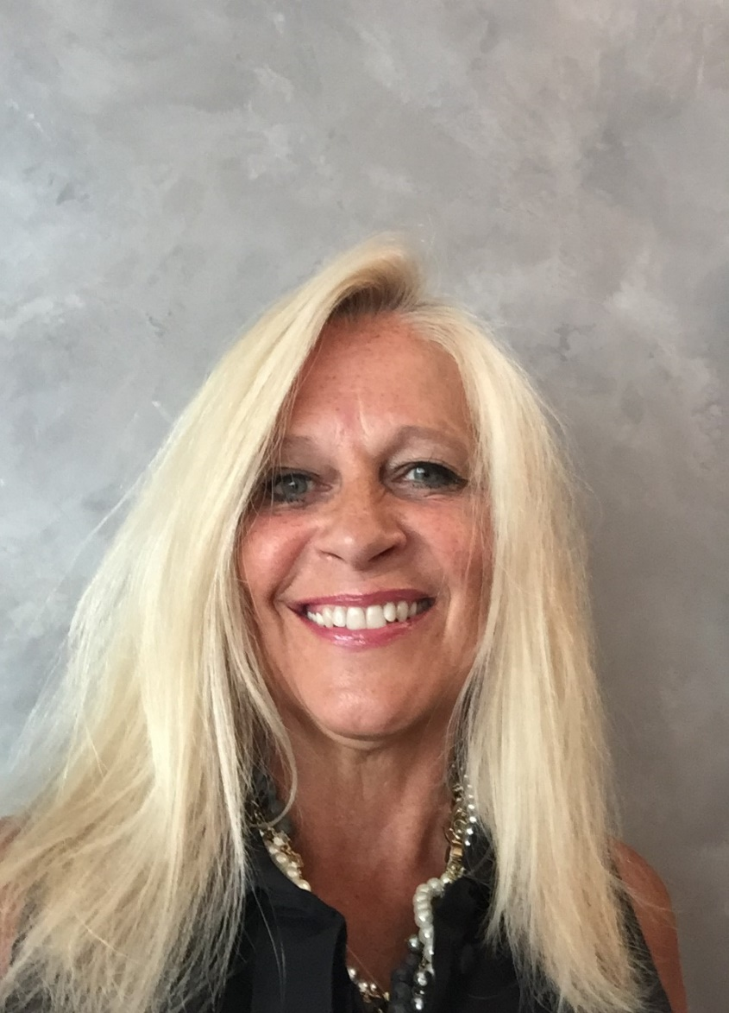
CAROL BALINTFY

Slide 16
ALPHA RHO
2015 -2016

Slide 17
LINDA BILLOTTE
2015

Slide 18
JENNIFER CERVENIC
2015

Slide 19
SALLY DEANE
2015

Slide 20
Colleen M. Hurd
2015

Slide 21
Wendi Walton
2015

Slide 22
Elizabeth Winsor
2015

Slide 23
JESSICA CARPENTER
2016

Slide 24
KIM CLARK
2016

Slide 25
BETSY DRAKE
2016

Slide 26
WENDY KNOTT
2016

Slide 27
SUE TANNER
2016

Slide 28
ALPHA THETA
2015

Slide 29
DIANE LANZO

Slide 30
LAURA MOORE

Slide 31
LAUREL PITZRICK

Slide 32
VICTORIA SCARPELLO

Slide 33
BETA
2016

Slide 34
MICHELLE BASSETT

Slide 35
KAREN CURRAN

Slide 36
SARA EARL

Slide 37
CAITLIN GOODWIN

Slide 38
CHRISTINE GREGORY

Slide 39
ALLISON KEISER

Slide 40
BONNIE MELDRIM

Slide 41
CAITLIN NESKE

Slide 42
DEDREA SCALZA

Slide 43
LINDA SCOFIELD

Slide 44
CYNTHIA TROY

Slide 45
MEGAN TURSHMAN

Slide 46
BETA DELTA
2015

Slide 47
JENNIFER BARTLETT-PRATI

Slide 48
TARA MONTGOMERY

Slide 49
AMANDA PUNDT

Slide 50
ERICA SINICROPI

Slide 51
KATIE WRIGHT

Slide 52
BETA OMEGA

Slide 53
MICAELA ETHIER

Slide 54
MAUREEN WHALEN

Slide 55
BETA OMICRON
2017

Slide 56
MARY HINKLEY

Slide 57
PAM KRUPPO

Slide 58
ABBY LOSI

Slide 59
NANCY PIPER

Slide 60
MELISSA WHITE

Slide 61
BETA TAU

Slide 62
ANNE TOPPING MOSHER

Slide 63
GAMMA ALPHA
2015-2017

Slide 64
ELAINE CALLOW
2015

Slide 65
BASANTI CHAKRABORTY
2015

Slide 66
DEBORAH FUDGE-RHEM
2015

Slide 67
KIRSTEN GRUNBERG
2015
TRANSFER

Slide 68
CHRISTINE HANNA
2015

Slide 69
MARY LUSTER-CARPENTER
2015
TRANSFER

Slide 70
DEBORAH OTTENBERG
2015

Slide 71
HUYEN HOANG THANH WORLD FELLOWSHIP RECIPIENT
2017

Slide 72
GAMMA DELTA
2016

Slide 73
SARAH BOLAND

Slide 74
APRIL CARERE

Slide 75
VIRGINIA HENDRA

Slide 76
LAMBDA
2017

Slide 77
NICOLE CONANT

Slide 78
ELAINE DRISCOLL

Slide 79
OMEGA
2016

Slide 80
ANNE FORBES

Slide 81
JENNIFER HARRIS

Slide 82
Mother Daughter
Initiates

Slide 83
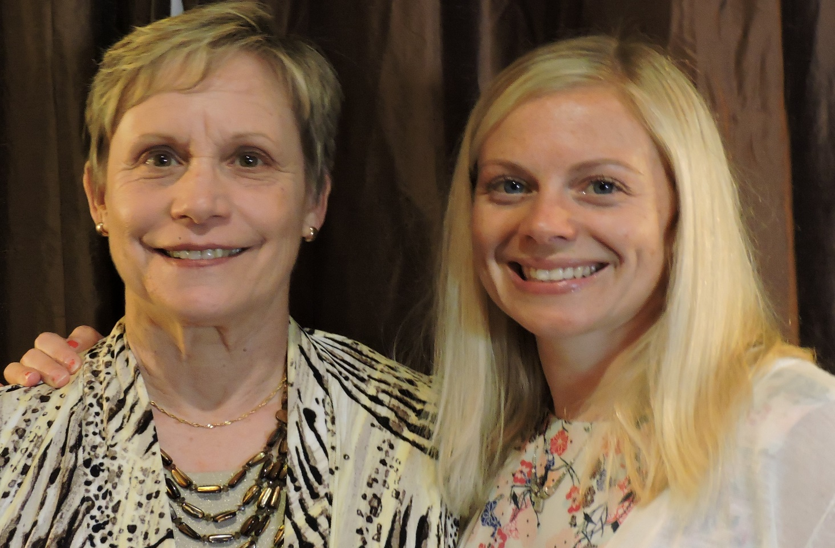
MARY LOU LAWRENCE & KIRSTEN CARR

Slide 84
JACQUELINE JOHNSON

Slide 85
KIRSTIN JABARA

Slide 86
KIRSTIN WAHL

Slide 87
KAREN BUSBY

Slide 88
TAMMY OLMSTEAD

Slide 89
PI
2016

Slide 90
APRIL ERICKSON

Slide 91
CLAUDIA ROCKWELL

Slide 92
PSI

Slide 93
CAROL LOWERY

Slide 94
TAU
2016

Slide 95
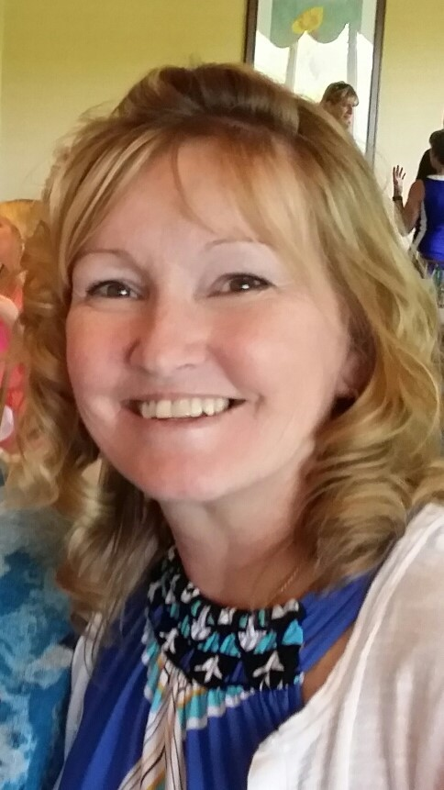
ELIZABETH HUGGLER

Slide 96
NANCY HACKETT

Slide 97
SUSAN KAUFMAN

Slide 98
DEBI LEVINE

Slide 99
SHARI MEDNICK

Slide 100
ROBIN PATEL

Slide 101
NICOLE RIZZO

Slide 102
WENDY SEWARD

Slide 103
ZETA
2016

Slide 104
DAWN DANCY

Slide 105
STACY RHUBIN

Slide 106
IF WE HAVE MISSED SOMEONE, PLEASE LET US KNOW!
A SPECIAL THANK YOU TO MARY-MARTHA HARVEY

